Slide 1
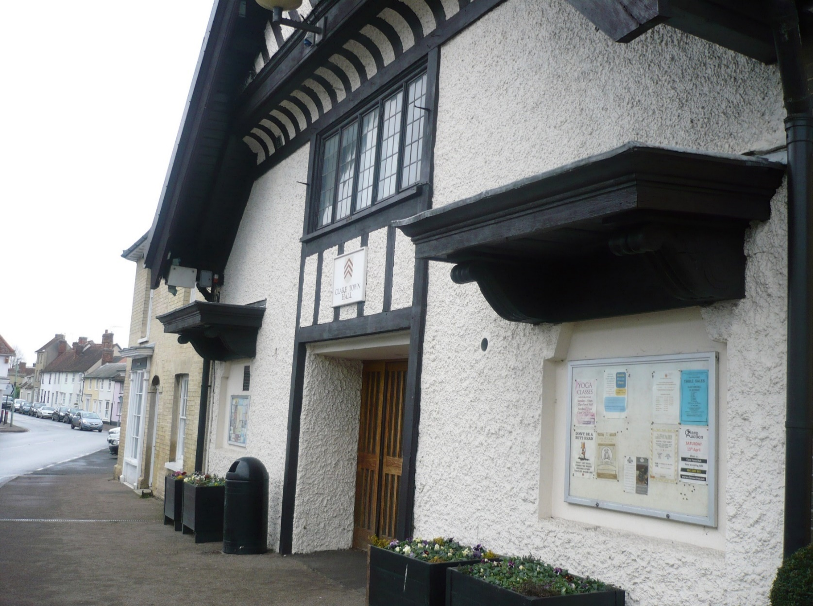
Neighbourhood Planning in West Suffolk Information for parishes

Slide 2
What we will cover
Neighbourhood Plan overview
The Process
Our offer and role in the process
Neighbourhood Plans currently being prepared in West Suffolk
Where to look for guidance
Questions

Slide 3
Neighbourhood Plan Overview
Gives communities direct power to develop a shared vision for their neighbourhood and shape the development and growth of their local area.
They are able to choose where they want new homes, shops and offices to be built
Provides a set of tools for local people to ensure that they get the right types of development for their community
Aligns the ambition of the neighbourhood with the strategic needs and priorities of the wider local area.

Slide 4
A neighbourhood plan is…
Pro-growth – a tool which allows a community to plan for more growth than proposed in the council’s Local Plan;
community led;
evidence based;
locally specific;
contains policies focused on development and land use;
a tool for allocating sites;
a plan to identify community goals that can be met by planning for development;
aligned with the strategic policies in the council’s Local Plan and meet other basic conditions;
subject to public consultation, examination and a referendum.

Slide 5
A neighbourhood plan isn’t…
a tool to prevent development that is included in the Local Plan;
a means of setting out community aspirations – include activity that may be about development but cannot be delivered in the plan period;
a tool to set out non land-use projects and proposals

Slide 6
Neighbourhood Plans cannot
be used to stop growth
Must comply with:
European Directives/legislation (!)
National Legislation (Planning & Other)
National & Local Planning Policy
They cannot propose lower levels of growth, housing etc.
But can help inform, direct and shape development
Should be community led and evidence based
Subject to independent examination & referendum

Slide 7
What are the benefits?
Run by the community
Up to date evidence
Local nuance on adopted/ emerging development plan
Makes unique planning policies
Helps guide development decisions
Access Grant funding
Access Technical Support
Disadvantages?
Grant information and Technical Support Locality – https://neighbourhood.planning.org/

Slide 8
How to develop a Neighbourhood Plan?
Set objectives, establish Steering Group
Create a Neighbourhood Area
Community engagement, Gather data (Evidence base)
Assess data, draft policies, Write the Plan
Pre-submission Consultation, then Amendments
Submission
Independent Examination
Referendum
The Plan is “made”

Slide 9
Neighbourhood Area
The neighbourhood area has to be proposed by the
Parish/Town Council and approved by the Local Planning Authority(s)
Parish/Town Council administrative boundary
Options:
All of area
Part of area
Link with adjacent parishes

Slide 10
Engagement
Must engage with the community and other stakeholders:
Residents
Business Groups
Interest Groups
Public agencies

Slide 11
Must be based on sound evidence
Demographic - who lives here? current and trends
Socio-economic - who works? where? & at what?
Environmental issues - flooding, air quality
Designations - heritage, landscape, wildlife
Transport - services, capacity, usage
Infrastructure - capacity, fitness for purpose, need
Housing stock - type, tenure, condition, need
Land uses - potential development sites

Slide 12
Draft Plan is submitted for examination to an independent Inspector who:
Checks that it meets the basic conditions:
Conformity with EU and UK law
Conformity with the NPPF and local policy
Contributes to sustainable development
Recommends:
Whether it’s put to referendum
Who is included in the vote

Slide 13
Referendum
LPA to meet costs & make arrangements for referendum.
Where referendum results in a majority ‘Yes’ vote (50% + 1) LPA must make the plan & bring into legal force
No requirements for minimum turn out
Referendum asks one yes/no question such as “Do you want West Suffolk Council to use the neighbourhood plan for Newmarket to help it decide planning applications in the neighbourhood area?"

Slide 14
Status of Neighbourhood Plans
West Suffolk uses policies, (including the Local Plan), and any other relevant ‘material planning considerations’ to assess the planning applications it receives
Adopted Neighbourhood Plans are part of this assessment, informing decisions and/or any appeals arising

Slide 15
Our offer and role in the process
Provide a named officer as a first point of contact for advise and technical support;
provide advice to parish and town councils on:
The legal procedures to be followed;
Relationship with current planning policy in West Suffolk;
Methods of consultation and engagement;
Contacts for statutory undertakers or other key consultees;
The requirements of other legislation such as the Habitats Regulations and
Strategic Environmental Assessment;
emerging drafts of plans;
funding and grants available;
digitising the final proposals/policy maps;
getting the best from any paid support from contracted consultants

Slide 16
Neighbourhood Planning in West Suffolk (May 2020)
Hargrave Neighbourhood Plan – Made July 2018
Newmarket Town Council – Made February 2020
Barrow cum Denham – area designated June 2019
Barningham Parish Council – area designated April 2017
Exning Parish Council – area designated June 2018 (decided not to pursue plan)
Freckenham – area designated November 2018
Great Barton Parish - area designated June 2016 (updated January 2019)
Ixworth and Ixworth Thorpe Parish Council – area designated July 2017
Withersfield – area designated January 2020
Information on all Plans being produced in West Suffolk can be seen at
www.westsuffolk.gov.uk/neighbourhoodplanning

Slide 17
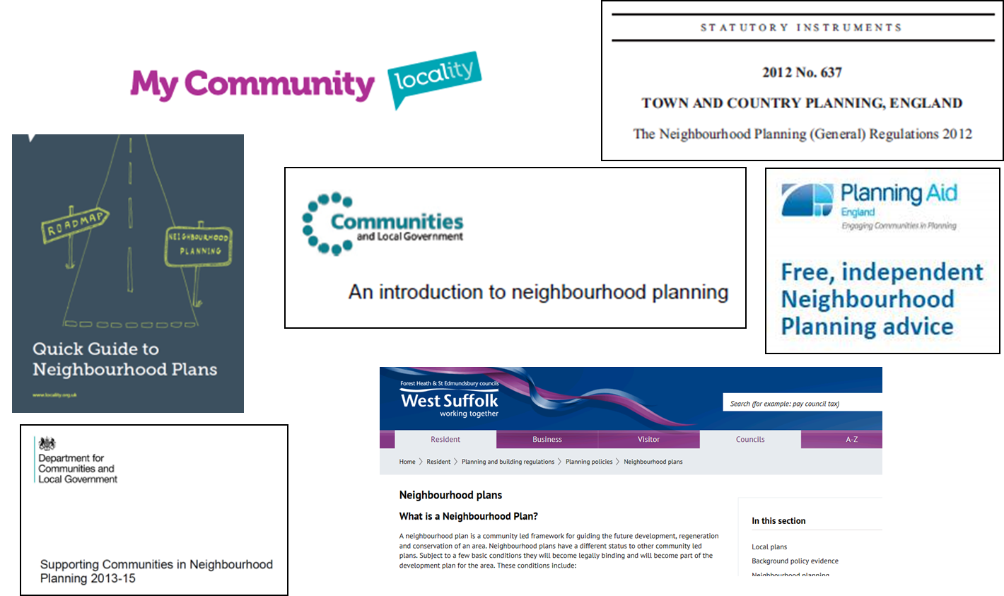
Guidance

Slide 18
Covid-19 and Neighbourhood plans April 2020 government update
Regulations linked to the Coronavirus Act 2020 mean that no elections or referendums can take place until 6 May 2021. This includes neighbourhood planning referendums. These provisions will be kept under review and may be amended or revoked in response to changing circumstances.
current planning guidance has been updated nationally to set out that neighbourhood plans awaiting referendums can be given significant weight in decision-making.
There will be delays in progressing neighbourhood plans due to the social distancing measures currently in place across the UK. The updated planning guidance also provides further advice on the implications for conducting publicity and consultation, and examinations.
Grants and technical support will continue to be available to support communities during the next financial year, and Locality’s advice service continues to operate as normal.
Contact: neighbourhood.planning@westsuffolk.gov.uk

Slide 19
Questions?
Contact: neighbourhood.planning@westsuffolk.gov.uk

